Slide 1
Market & Customer Insights (2010–2011)
Doan Huynh Nhat Vu

Slide 2
External Factors
Product & Services
Customers
  The United Kingdom accounts for ~85% of total revenue, highlighting the importance of the domestic market alongside cross-border sales.
  Q4 (October-December) contributes up to ~38% of the total annual revenue, primarily driven by Christmas shopping demand
  Product Profile: The focus is on gifts, decorations, and souvenirs with an affordable price point (most items are < £5).
GAP: ~75% of transactions have CustomerID. ~25% missing → limits CLV and segmentation accuracy
  Geographic Spread: Despite international presence, UK buyers = 85% of revenue
SMEs as Dominant Revenue Drivers:
  Top 27% customers contribute ~81% of total revenue
  SMEs show higher Frequency, Monetary value, and AOV
  Month-1 retention for SMEs ~45%, higher than individual buyers
Category | Revenue | % Total Revenue
Decorations & Gifts | £1,649,446 | ~ 19%
Bags & Accessories | £964,365 | ~ 11%
Homeware & Kitchen | £870,128 | ~ 10%
Conclusions & Strategic Issues
⚠️ Seasonality Risk:
An over-reliance on Q4 revenue. A strategy is needed to mitigate this risk and boost sales in other quarters.
🎯 SMEs as Key Revenue Drivers:
This customer segment provides the most value. Retention and growth strategies for SMEs should be the top priority.
❓ Customer Identification Gap:
The lack of customer information hinders personalized marketing strategies and loyalty programs.

Slide 3

PROJECT: Customer-Centric Growth Plan
OBJECTIVES: Increase non-Q4 revenue +15% YoY, boost SME CLV +10%, and achieve >85% CustomerID coverage within 12 months
GOALS:
  Increase non-Q4 revenue by +15%
  Retain top 20% SMEs → increase CLV by +10%
  Improve CustomerID coverage from ~75% → 85%
STRATEGY
MEASUREMENTS
Action plan
Metrics
  Strategy 1: Diversify Seasonality
  Expand “non-seasonal” product lines (e.g., household goods, stationery).
  Run year-round promotions → create mini-peaks in Q2 & Q3.
  (Based on shared-reality insight: Q4 contributes ~38% revenue → high seasonality risk)
  Expand "non-seasonal" product lines (e.g., household goods, stationery)
  Run year-round promotions to create mini-peaks in Q2 & Q3.
  % of total revenue generated outside Q4
  YoY sales uplift in Q2 & Q3 (%)
CURRENT BASELINE (Starting Point):
  ~38% of annual revenue is generated in Q4.
  Top 27% of customers generate ~80% of revenue
  Average month-1 retention is ~22%
  Current CustomerID coverage is ~75%
  Strategy 2: SME Retention & Loyalty
  Launch SME loyalty program (membership tiers)
  Offer bulk purchase discounts for SMEs.
  (Based on shared-reality insight: Top 27% customers (SMEs) generate ~80% revenue → SMEs are the core value segment)
  Launch SME loyalty program with membership tiers in Q2
  Offer bulk purchase discounts for SMEs
  SME repeat purchase rate (%)
  Average order value (AOV) SMEs
  Strategy 3: Customer Identification & Data Enrichment
  Incentivize account registration (voucher on 2nd purchase).
  Integrate email/phone tracking to monitor repeat purchases.
  (Based on shared-reality insight: ~25% transactions missing CustomerID → limits CLV analysis & loyalty initiatives)
  Incentivize account registration (e.g., voucher on 2nd purchase)
  Collect & enrich customer data (email, phone)
  % orders with CustomerID
  % of customers with valid contact info

Slide 4
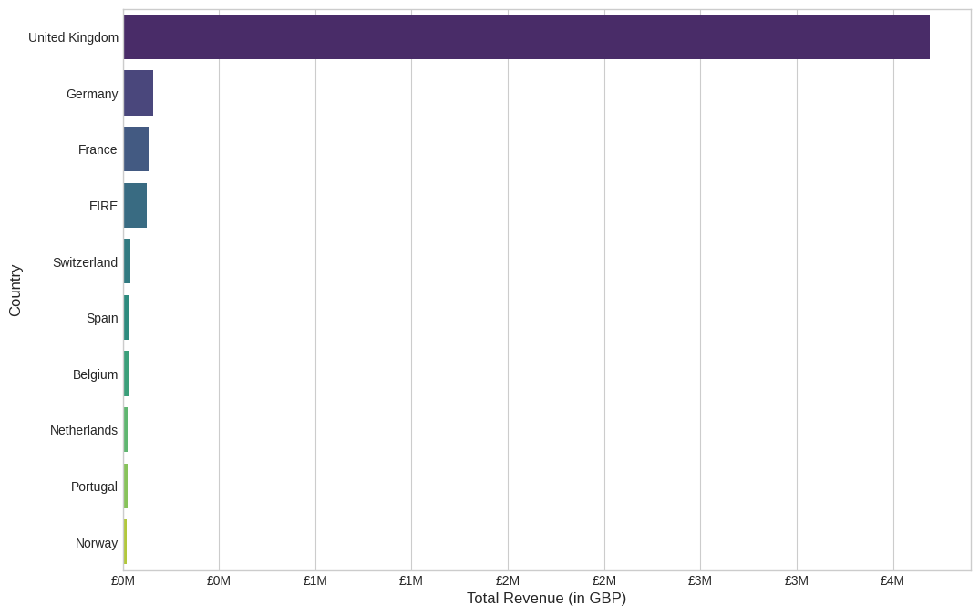
UK accounts for ~85% of total revenue
To illustrate the conclusion regarding the UK market's dominance (Shared reality Appendix), this chart shows that revenue from the United Kingdom overwhelmingly surpasses all other countries, accounting for approximately 85% of total revenue.

Slide 5
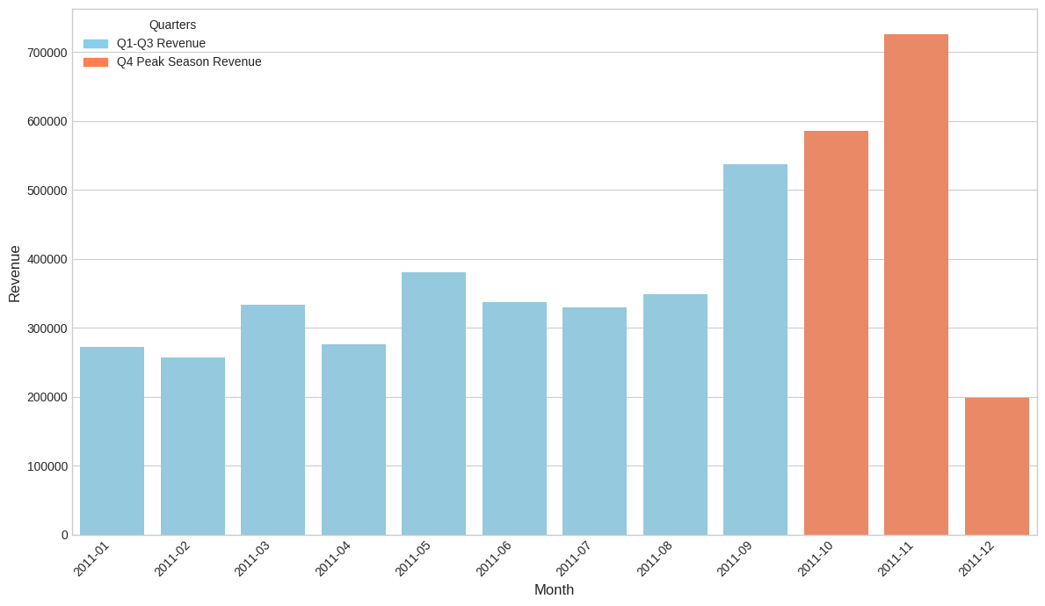
Q4 contributes ~38% of annual revenue (strong seasonality)
This monthly revenue trend chart provides clear evidence of the "Seasonality Risk" (Shared reality Appendix), showing a dramatic revenue spike in Q4, primarily driven by Christmas shopping demand.

Slide 6
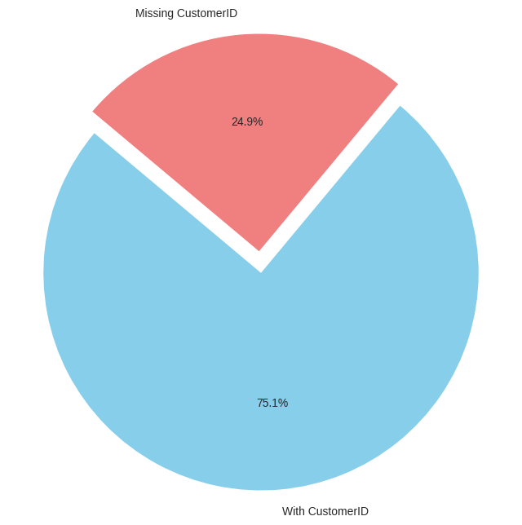
~25% of transactions lack CustomerID (identification gap)
This chart highlights the "Customer Identification Gap" (Shared reality Appendix). Approximately a quarter of all transactions are missing a CustomerID, which poses a significant challenge for deeper analysis of customer behavior and loyalty.

Slide 7
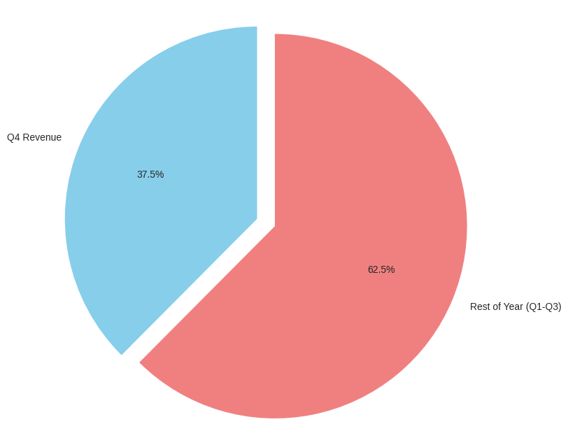
Q4 vs. Rest of Year: Q4 = 38% revenue share
To further clarify the baseline metrics for the Growth Plan (OSGM Appendix), this pie chart visualizes the revenue share. It highlights the significant seasonality, showing that 37.5% of the total annual revenue is generated in Q4 alone.

Slide 8
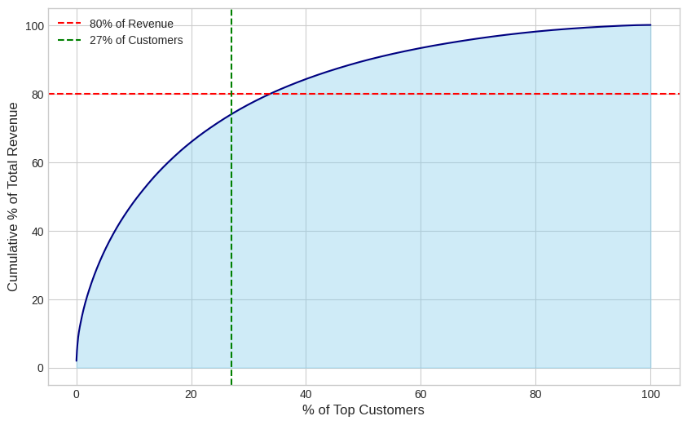
Top 27% customers generate ~80% of total revenue (Pareto)
This Pareto analysis reinforces the conclusion that SMEs are the "Key Revenue Drivers" (Shared reality Appendix). The chart demonstrates that a small group of top customers (approx. 27%) generates the vast majority of revenue (80%), emphasizing the importance of their retention.

Slide 9
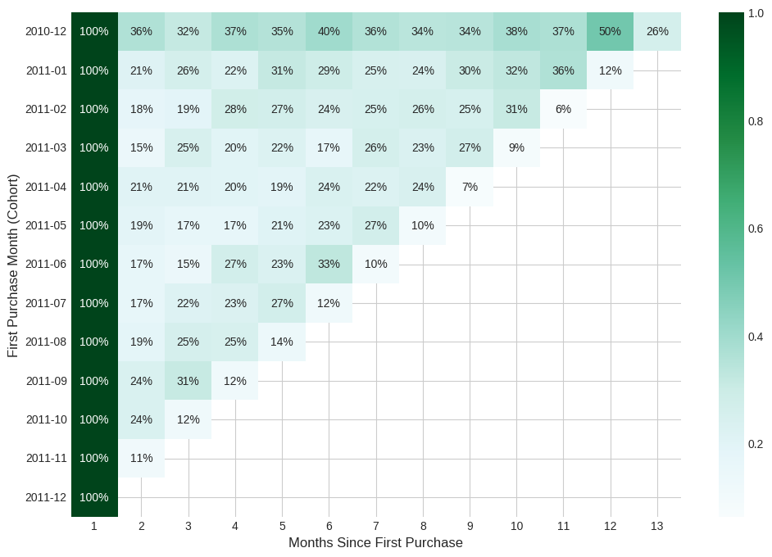
Month-1 retention ≈ 22% (low retention baseline)
This cohort analysis provides the baseline for customer retention (OSGM Appendix), a critical metric for the SME retention and loyalty strategy. We can see that, on average, only about 22% of new customers return to make a purchase in the second month.

Slide 10
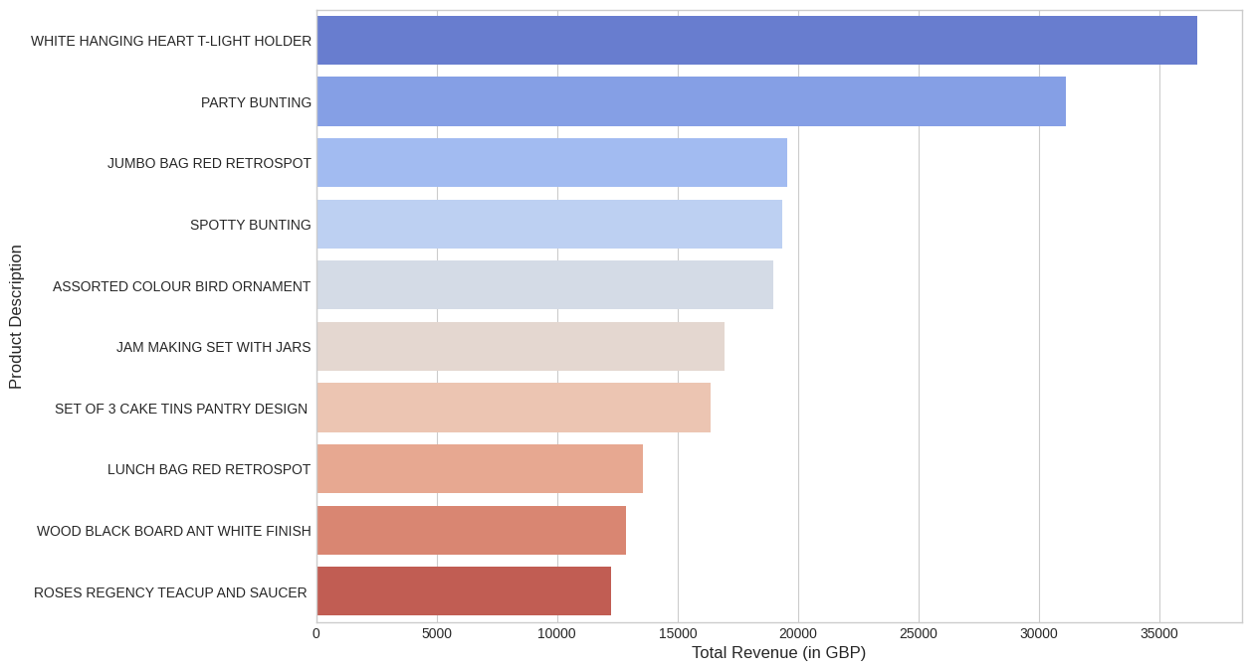
Best-selling non-Q4 products (seasonality diversification inputs)
In support of the "Diversify Seasonality" strategy (OSGM Appendix), this chart identifies the best-selling products outside of the Q4 peak. These are potential candidates for expansion and year-round promotional activities.

Slide 11
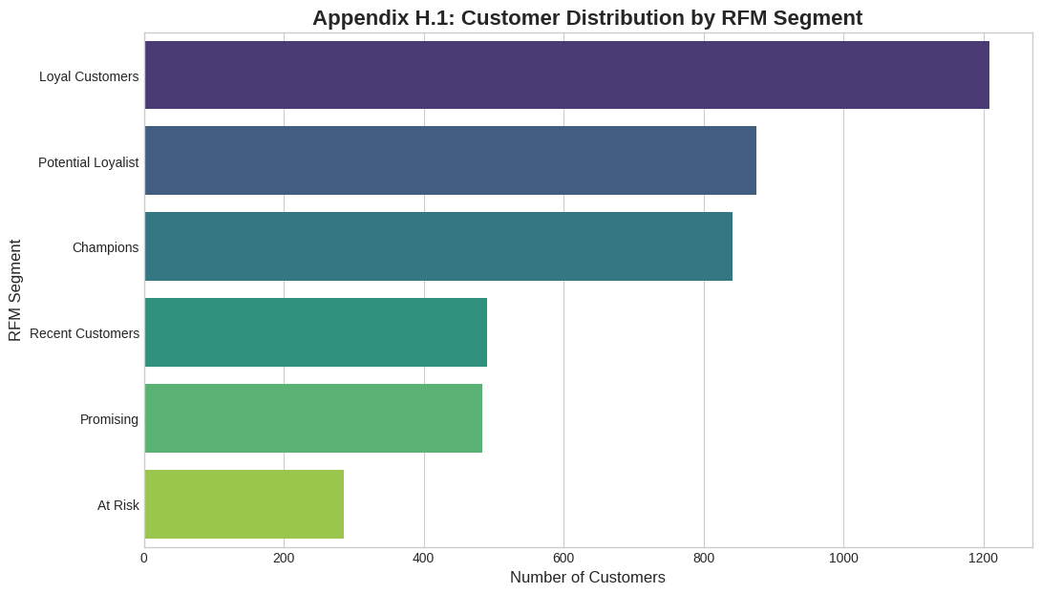
RFM segmentation: Loyal & Champions drive majority of value
To effectively target our loyalty program (Strategy 2), we first segmented customers using the RFM model. This chart shows the distribution of customers across different value tiers, identifying "Loyal Customers" as the largest group by count, followed closely by "Champions" and "Potential Loyalists".

Slide 12
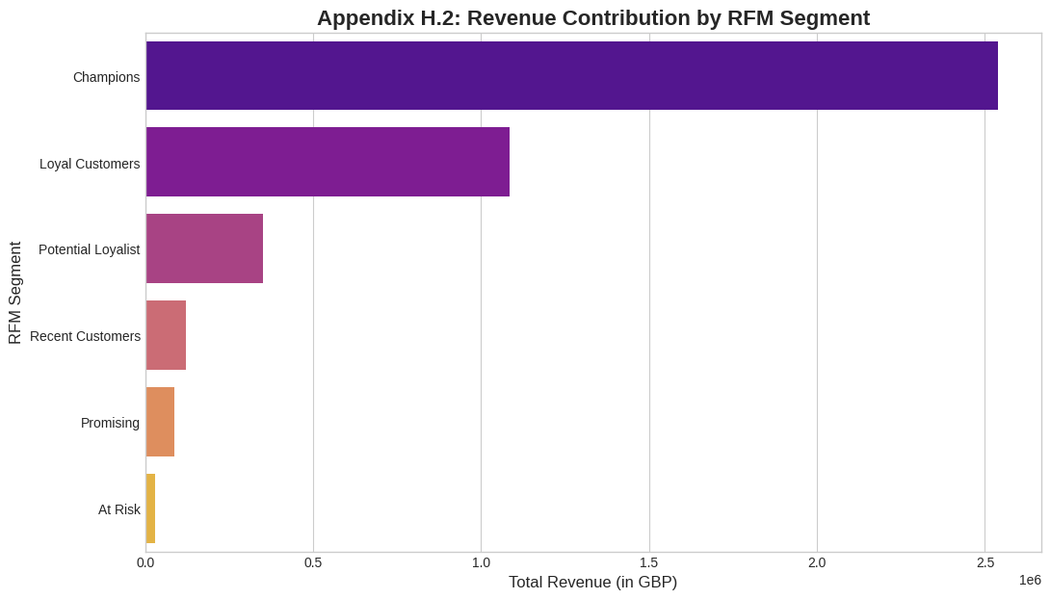
RFM segmentation: Loyal Customers = largest segment by count
While "Loyal Customers" are numerous, this chart reveals where the most value lies. The "Champions" segment, despite being smaller in size, contributes disproportionately to the total revenue. This reinforces the critical importance of retaining this high-value group to achieve our CLV growth targets.

